Slide 1
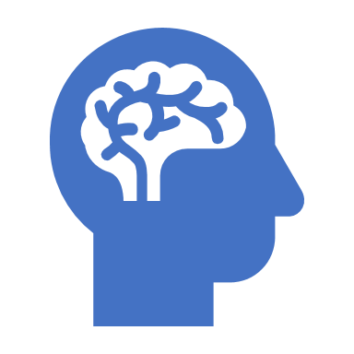
A HOLISTIC APPROACH FOR NURSES: WHO'S ASSESSING MENTAL HEALTH & ADVERSE CHILDHOOD EFFECTS
Priscilla J. Murphy LPCMH, MEd,BSN,RN
Nylex Educational & Counseling Services, Inc.
2601 Annand Dr. Unit 20
Wilmington, DE 19808
302-898-3261

Slide 2

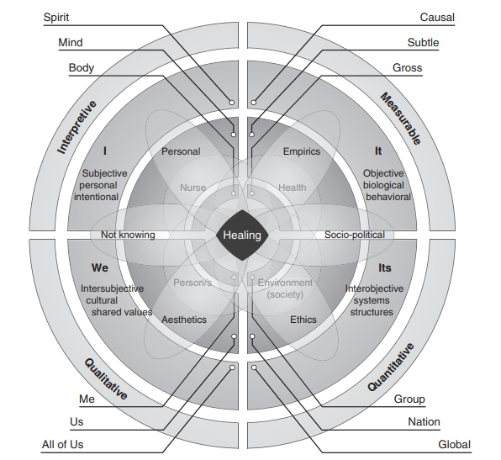

Slide 3
Holistic nursing: Focusing on the whole person
Holistic nursing is generally defined as all nursing practice that has healing the whole person as its goal. A holistic nurse is a licensed nurse who takes a “mind-body-spirit-emotion-environment” approach to the practice of traditional nursing. Holistic nursing is based on a philosophy of living and being that is grounded in caring, relationship, and interconnectedness. A holistic nurse recognizes and integrates the principles and modalities of holistic healing into daily life and clinical practice. Holistic nursing encourages nurses to integrate self-care, self-responsibility, spirituality, and reflection in their lives.

Slide 4
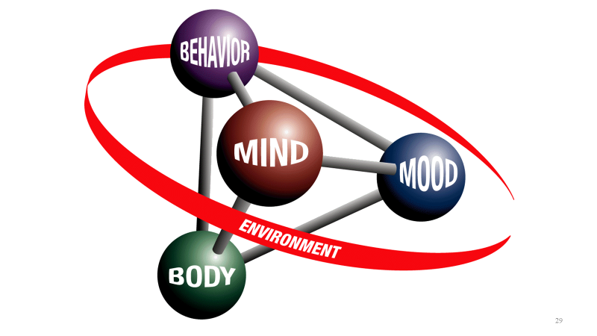

Slide 5
PRINCIPLES OF INTEGRATIVE NURSING
The University of Minnesota lists six principles of integrative nursing:
Humans are whole systems, and cannot be separated from their environments. Humans consist of body, mind, and spirit, and all must be in balance for optimal health and comfort. The environment does affect human health.
Humans have the capacity to self-heal. The human body can heal itself on physical, social, emotional, and spiritual levels.
Nature has the power to help people heal and lift their spirits. Research shows that exposure to nature has positive effects, even it’s just a plant-filled space in a hospital. The environment also affects staff members, not just patients.
The basis of integrative nursing is creating relationships and focusing on the individual as a whole, not on specific symptoms. For optimal outcomes, medical care provider and patient must create a relationship. Integrative nurses must listen, provide options and spend time fully present with patients and their family members.
Evidence guides integrative nursing, which uses a variety of therapies to support healing, starting with the least invasive method. Integrative nursing calls on natural healing and soothing to supplement medical interventions. Some treatment plans may include massage, acupuncture, breathwork, and stretching. As needed, plans are adjusted to move into more intensive methods.
Integrative nurses take care of caregivers too. While patients are obviously the priority, these nurses also watch out for and encourage caregivers to practice their own self-care.
https://www.askdrmaxwell.com/2018/04/integrative-nursing-is-about-more-than-treating-symptoms/

Slide 6
The American Holistic Nurses Credentialing Corporation (AHNCC)
The American Holistic Nurses Credentialing Corporation (AHNCC) advances holistic nursing and nurse coaching through certification. Holistic nurses and nurse coaches promote health, wellness, and wellbeing as they facilitate their client’s growth and healing. Both certifications offer nurses a way to distinguish themselves as experts in nursing practice, education, and research. The examinations are accredited by the Accreditation Board for Specialty Nursing Certification [ABSNC] and are recognized by the American Nurses Credentialing Center [ANCC] Magnet Program.
http://www.ahncc.org/

Slide 7
SCIENTIFIC UNDERPINNINGS OF HOLISTIC NURSING
Holistic Nurses draw from the basic and behavioral sciences; the foundation of Holistic Nursing is the sciences of holism, health, wellness, wellbeing, and healing. These include, but are not limited, to those that address:
•Normal, healthy processes such as anatomy, physiology, microbiology, chemistry, psychobiology and psychoneuroimmunology
•Energy theories based on quantum physics
•Human growth and development from conception through transcendence.

Slide 8
HOLISTIC PROCESSES
These sciences describe, explain, and/or predict normal holistic processes, as well as alterations and deviations that result in illness, sickness, and/or disease.
Rather than emphasizing the outcome of these alterations and deviations, Holistic Nurses focus on the root of the problem—what stimulated the response that affected the normal processes, causing them to deviate from health and wellness.
Nursing theories that reflect core values of Holistic Nursing, draw from these sciences, and propose what nurses can do to intervene to address the root of the problem.
The Holistic Caring-Healing Process is dynamic, cyclic, spiraling, and non-linear. There is an intentional focus on integration, unity, and healing of the holistic person.

Slide 9
INTEGRAL AND HOLISTIC NURSING: LOCAL TO GLOBAL
Discussion Questions:
  What is mean by Local level of Nursing?
  What is between the local level and the global level of nursing?
  Why is it good to keep a broader perspective in the context of each individual patient/client?

Slide 10
Holistic Nursing: Scope and Standards of Practice
Mind-Body Connection
Scope of Intervention
Standards of Clinical Practice
Standards of Ethical Practice

Slide 11
: Current Trends and Issues in Holistic Nursing
Bio-Psycho-Social-Spiritual Assessment Process
Multi-Disciplinary Intervention Process
Where are the boundaries of holistic nursing?
Mental Health Problem indicators to start assessment process.
Adequate referrals as part of case management and integrated care.

Slide 12
Transpersonal Human Caring and Healing
Ability to care and be a healer without boundary violations.
Nature of transpersonal caring.
Discussion about mind-body connection in the context of transpersonal caring/healing.

Slide 13

NURSING THEORY IN HOLISTIC NURSING PRACTICE
Nursing theory is defined as "a creative and rigorous structuring of ideas that project a tentative, purposeful, and systematic view of phenomena". Through systematic inquiry, whether in nursing research or practice, nurses are able to develop knowledge relevant to improving the care of patients.

Slide 14
NURSING: HOLISTIC, INTEGRAL, AND INTEGRATIVE
In 2010, the Institute of Medicine’s landmark report, The Future of Nursing, presented four key messages:
1. Nurses should practice to the full extent of their education and training.
2. Nurses should achieve higher levels of education and training through an improved education system that promotes seamless academic progression.
3. Nurses should be full partners, with physicians and other healthcare professionals, in redesigning health care in the United States.
4. Effective workforce planning and policymaking require better data collection and information infrastructure.
Reference: http://samples.jbpub.com/9781284072679/Chapter1_Sample.pdf

Slide 15
THE HOLISTIC CARING PROCESS - CULTURE CARE THEORY
As a nurse, Madeleine Leininger recognized a lack of cultural and care knowledge as a missing component in nursing and patient care. From her experiences, she developed transcultural nursing and the Cultural Care Theory to study and explain the outcomes of transcultural nursing.
Providing care that is in harmony with a patient’s cultural beliefs, practices and values. “Culturally congruent care,” is the primary goal of transcultural nursing. Some of the basic tenets of transcultural nursing include an understanding of the following:
  Cultural care diversity and universality, which refers to the differences and commonalities between different cultures.
  Cultural and social structure dimensions, which includes factors that include religion, social structures and economics that set cultures apart.
  Cultural care preservation or maintenance, which relates to nursing care activities that help specific cultures to retain the core cultural values related to healthcare.

Slide 16
SELF-ASSESSMENTS FOR HEALTH AND HEALING - SELF-CARE NURSING THEORY
Introduced by Dorothea Orem, the Self-Care Nursing Theory (also known as the Self-Care Deficit Nursing Theory) focuses on the nurses’ role in supporting the patients’ ability to be self-sufficient and responsible for their own care. The theory is based on the idea that people must be knowledgeable about their health problems to provide adequate self care. The theory is made up of three interconnected theories:
  theory of self-care
  the theory of self-care deficit
  the theory of nursing systems

Slide 17
RELATIONSHIP-CENTERED CARE
Relationship-centered care serves as a model of caregiving that is based in a vision of community where three types of relationships are identified:
(1) patient–practitioner relationships,
(2) community–practitioner relationships, and
(3) practitioner–practitioner relationships.
Each of these interrelated relationships is essential within a reformed system of health care, and each involves a unique set of tasks and responsibilities that address self-awareness, knowledge, values, and skills.
Reference:http://samples.jbpub.com/9781284072679/Chapter1_Sample.pdf

Slide 18
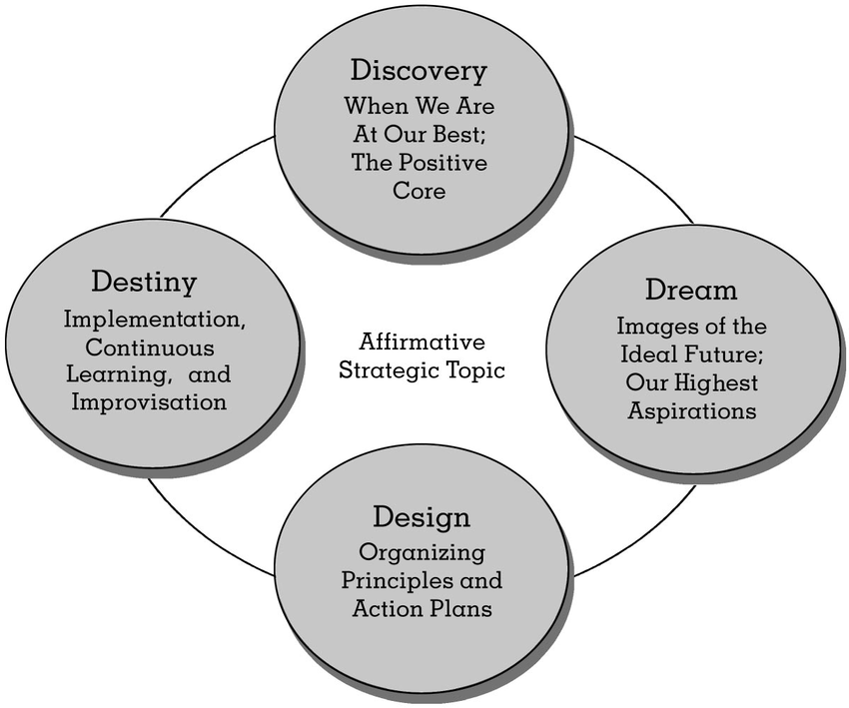
APPRECIATIVE INQUIRY AND MOTIVATIONAL INTERVIEWING

Slide 19
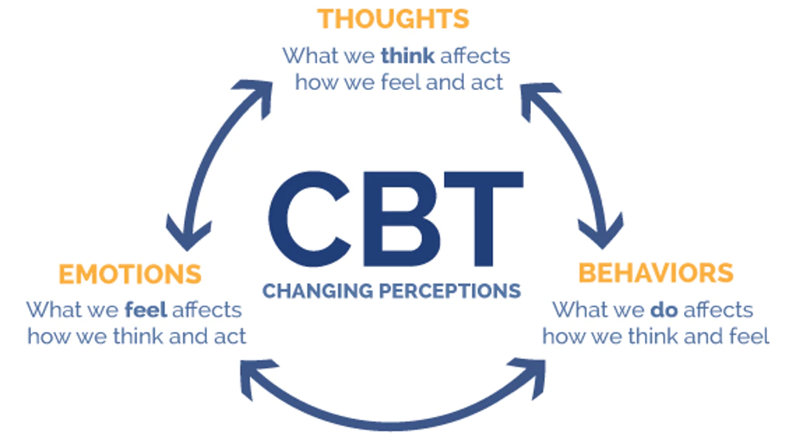
COGNITIVE THERAPY

Slide 20
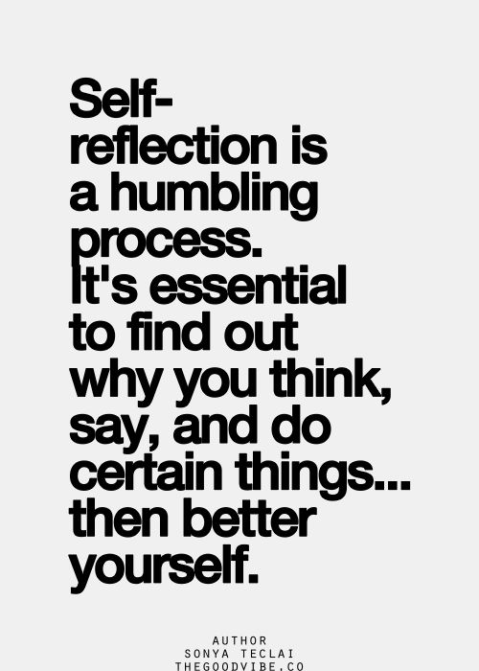
SELF-REFLECTION

Slide 21
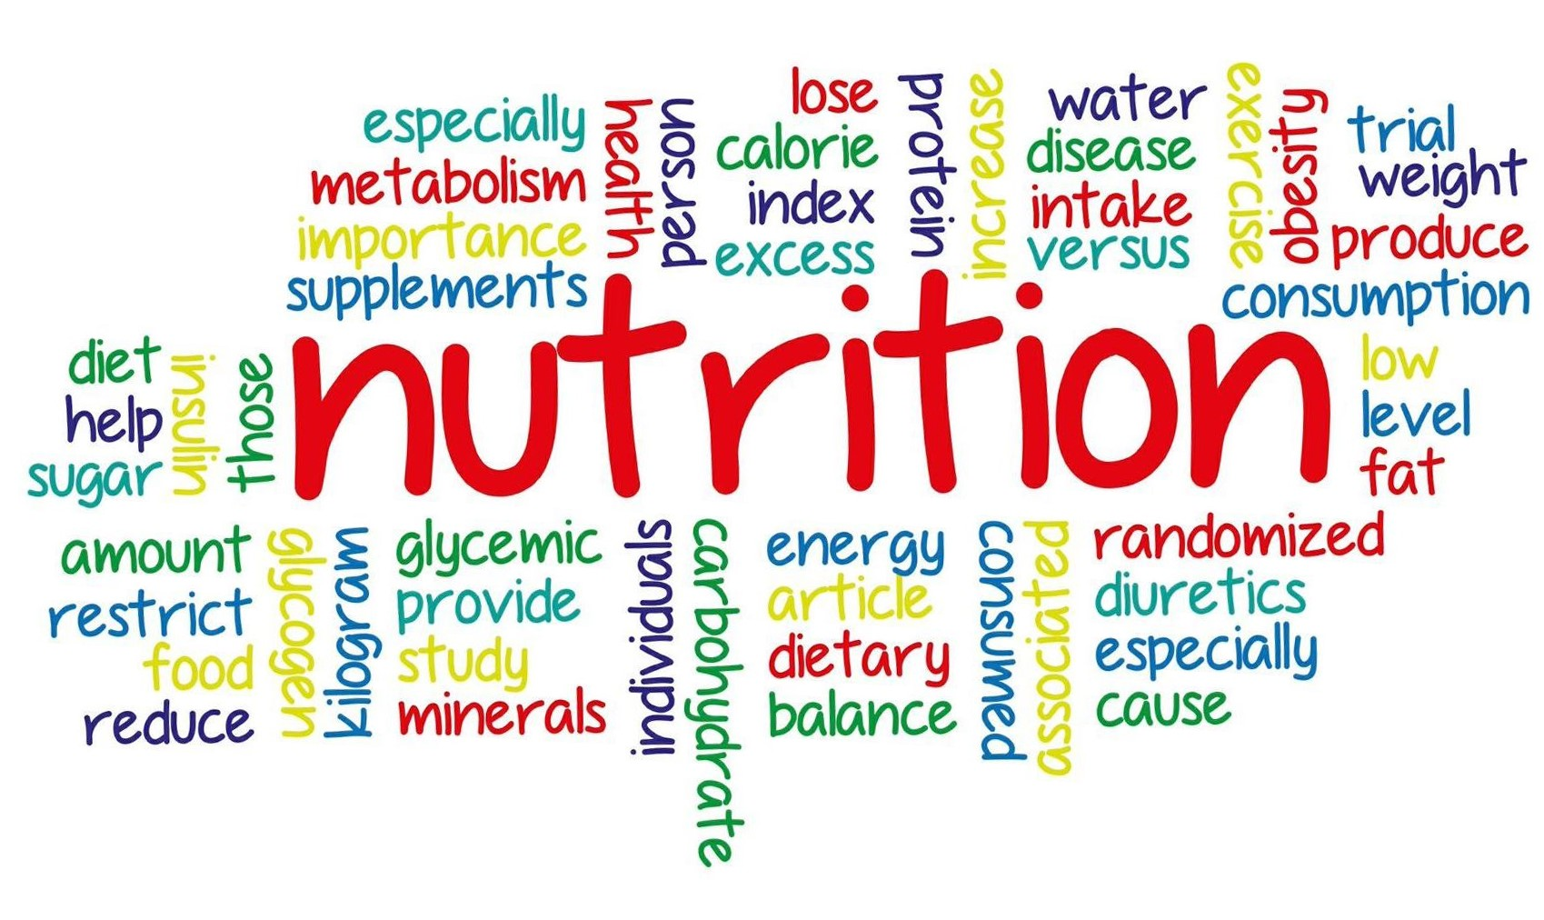
NUTRITION

Slide 22
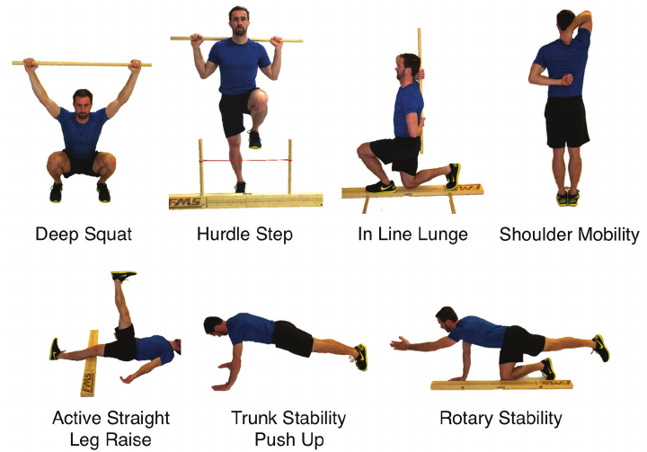
EXERCISE AND MOVEMENT

Slide 23
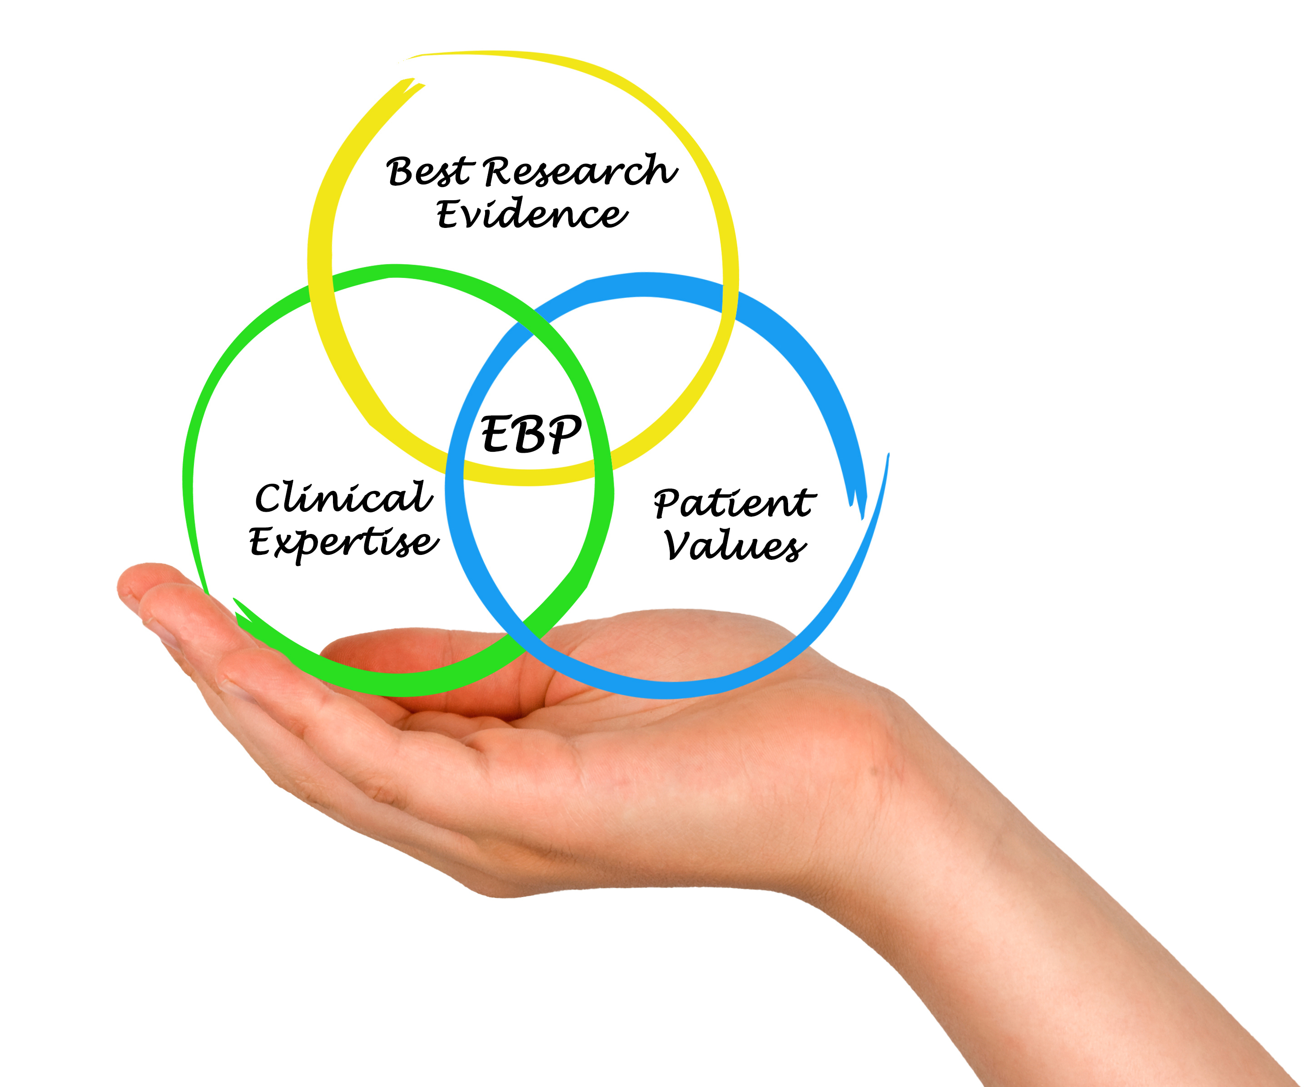
EVIDENCE-BASED PRACTICE

Slide 24
MENTAL HEALTH VS. MENTAL ILLNESS
Mental Health: The successful performance of mental function, resulting in productive activities, fulfilling relationships with other people, and the ability to adapt to change and to cope with adversity.
Mental Illness: The term that refers collectively to all mental disorders, which are health conditions characterized by alterations in thinking, mood, or behavior (or some combination thereof) associated with distress and/or impaired functioning. Mental Health Problems Signs and symptoms of insufficient intensity or duration to meet the criteria for any mental disorder. Source: DHHS (1999).
https://www.ncbi.nlm.nih.gov/books/NBK44243/pdf/Bookshelf_NBK44243.pdf

Slide 25

ADVERSE CHILDHOOD EXPERIENCES
Adverse childhood experiences (ACEs) are stressful or traumatic events, including abuse and neglect. They may also include household dysfunction such as witnessing domestic violence or growing up with family members who have substance use disorders. ACEs are strongly related to the development and prevalence of a wide range of health problems throughout a person’s lifespan, including those associated with substance misuse.

Slide 26
ACE’S INCLUDE:
Physical abuse
Sexual abuse
Emotional abuse
Physical neglect
Emotional neglect
Intimate partner violence
Mother treated violently
Substance misuse within household
Household mental illness
Parental separation or divorce
Incarcerated household member

Slide 27
HOLISTIC NURSING
ADDICTIONS
MENTAL HEALTH PROBLEMS
SPIRITUAL DEVELOPMENT PROBLEMS
* SUBSTANCE USE
* PROBLEM GAMBLING
* FOOD ADDICTION
* SEX ADDICTION
* INTERNET ADDICTION
* SHOPPING ADDICTION
DEPRESSION, ANXIETY, GRIEF
BIPOLAR DISORDER
ADHD, ODD, PERSONALITY DISORDERS, SLEEP-WAKE DISORDERS, PSYCHOSIS,
DISSOCIATIVE DISORDERS, EATING DISORDER, ETC….

Slide 28
COMMUNITY MOBILIZATION
This is a capacity building process
through which a community of individuals, organizations,
policy makers, or governmental representatives plans,
carries out, and evaluates activities on a participating basis
to improve health or other needs. Community mobilization
empowers individuals and groups to take some kind of
action to facilitate change based on needs they have
identified. Communities may initiate the process themselves
or maybe motivated by outsiders to act.

Slide 29

INTEGRATION
___Resolves guilt and can reveal past as a personal fact without shame or fear
___ Without forgetting the past, feels like a drug-free person and a part of the recovering community
___ Applies personal rules that prevent drug use nearly effortlessly
___ Helping others becomes an essential part of life
___ Openness to growth and self-improvement become second nature
___ Lives each day accepting the challenges, responsibilities, and satisfactions of work, love, and respect for others
___ Is no longer stimulated by old places, events, or people associated with prior drug use
___ Social network is every widening
Source: Coombs, Robert, H. (2001) Addiction recovery tools.
Publication Date: November 15, 2001 | ISBN-10: 0761920676 | ISBN-13: 978-0761920670 | Edition: 1s

Slide 30
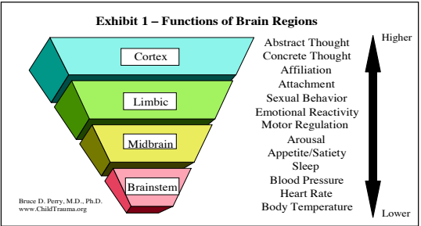
CHILD MALTREATMENT & BRAIN DEVELOPMENT

Slide 31

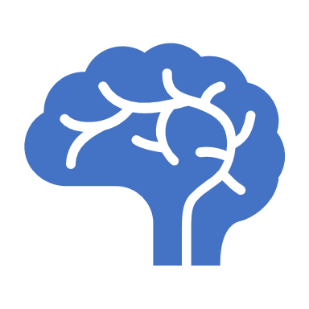
Changing Brains Mean that Adolescents Act Differently From Adults
Pictures of the brain in action show that adolescents' brains work differently than adults when they make decisions or solve problems. Their actions are guided more by the emotional and reactive amygdala and less by the thoughtful, logical frontal cortex. Research has also shown that exposure to drugs and alcohol during the teen years can change or delay these developments.

Slide 32
BASED ON THE STAGE OF THEIR BRAIN DEVELOPMENT, ADOLESCENTS ARE MORE LIKELY TO:
act on impulse
misread or misinterpret social cues and emotions
get into accidents of all kinds
get involved in fights
engage in dangerous or risky behavior
Adolescents are less likely to:
think before they act
pause to consider the consequences of their actions
change their dangerous or inappropriate behaviors
These brain differences don't mean that young people can't make good decisions or tell the difference between right and wrong. It also doesn't mean that they shouldn't be held responsible for their actions. However, an awareness of these differences can help parents, teachers, advocates, and policy makers understand, anticipate, and manage the behavior of adolescents.

Slide 33

ADOLESCENT BRAIN DEVELOPMENT
Adolescent Angst: 5 Facts About the Teen Brain
1. New thinking skills
2. Intense emotions
3. Peer pleasure
4. Measuring risk
5. 'I am the center of the universe’
Adolescents differ from adults in the way they behave, solve problems, and make decisions. There is a biological explanation for this difference... Other changes in the brain during adolescence include a rapid increase in the connections between the brain cells and making the brain pathways more effective.

Slide 34
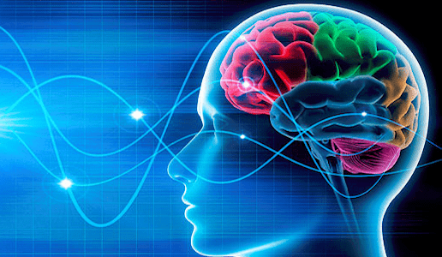
Plasticity—The Influence of Environment
Neuroplasticity: The brain's ability to reorganize itself by forming new neural connections throughout life. Neuroplasticity allows the neurons (nerve cells) in the brain to compensate for injury and disease and to adjust their activities in response to new situations or to changes in their environment.

Slide 35
RESPONDING TO STRESS
Types of stress and the timing of that stress determines whether and how there is an impact on the brain. According to the National Science Council on the Developing Child (2014), there are three classifications of stress:
Positive Stress: Moderate, brief, and generally a normal part of life.
Tolerable Stress: Includes events that have the potential to alter the developing brain negatively, but which occur infrequently and give the brain time to recovery.
Toxic Stress: Strong frequent, and prolonged activation of the body’s stress response system (e.g. chronic neglect.)

Slide 36
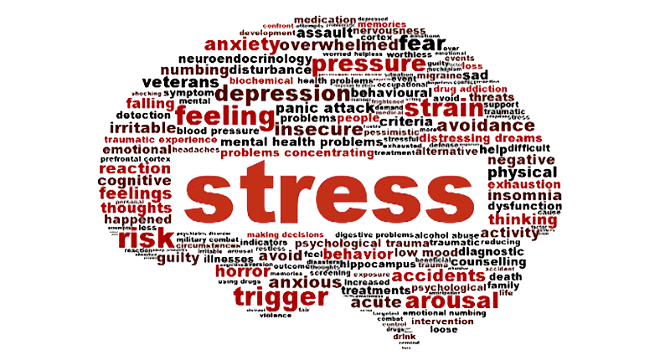
STRESS
Stress continues to be a major American health issue, according to the American Psychological Association. More than one-third of adults report that their stress increased over the past year. Twenty-four percent of adults report experiencing extreme stress, up from 18 percent the year before.
It’s well-known that stress can be a detriment to overall health. But can stress actually change the physiology of the brain? Science says yes.

Slide 37
EFFECTS OF MALTREATMENT ON BRAIN STRUCTURE AND ACTIVITY
Toxic Stress, including maltreatment, can have a variety of negative effects on children’s brains:
Adults who were maltreated may have reduced volume in the hippocampus, which is central to learning and memory.
Toxic stress can reduce the hippocampus’s capacity to bring cortisol levels back to normal after a stressful event has occurred.
Maltreated children and adolescents tend to have decreased volume in the corpus callosum, which is the largest white matter structure in the brain and is responsible for inter-hemispheric communication and other processes such as arousal, emotion, higher cognitive abilities.
  Maltreated children and adolescents tend to have decreased volume in the cerebellum, which helps coordinate motor behavior and executive functioning.
  Severely neglected children have a smaller prefrontal cortex which is critical to behavior, cognition, and emotion regulation.

Slide 38


DECISION
"Nothing is more difficult, and therefore, more precious, than to be able to decide." - Napoleon Bonaparte

Slide 39
The Amygdala and Cortisol Levels
Abuse and neglect can cause overactivity in the amygdala which helps determine whether a stimulus is threatening or trigger emotional response.
Maltreated children, especially those who experience severe neglect, tend to have lower then normal morning cortisol levels coupled with flatter release levels throughout the day. (National Science Council on the Developing Child, 2012)
Higher cortisol levels could harm cognitive processes, subdue immune and inflammatory reactions, or heighten the risk for affective disorders.

Slide 40
NEGLECT
Children who experience severe neglect early in life while in institutional settings often have deceased electrical activity in their brains, decreased metabolism, and poorer connections between areas of the brain that are key to integrating complex information.
Malnutrition, a form of neglect, impairs brain development and function.
Reference: National Council on the Developing Child, 2012

Slide 41
EFFECTS OF MALTREATMENT ON BEHAVIORAL,
SOCIAL, AND EMOTIONAL FUNCTIONING
Persistent Fear Response
Hyperarousal
Increased Internalizing Symptoms
Diminished Executive Functioning
Delayed Developmental Milestones
Weakened Response to Positive Feedback
Complicated Social Interactions

Slide 42
IMPACT OF MALTREATMENT ON ADOLESCENTS
Maltreatment effects brain development into adolescence and adulthood.
Cumulative effects of abuse or neglect throughout lives of adolescents.
Increase in impulsivity.
Brains focus on survival at the expense of more advanced thinking.
Difficulties with tasks that require higher level thinking.
Decreased levels of growth in the hippocampus and amygdala.

Slide 43
THE ROLE OF HEALTHY RELATIONAL
INTERACTIONS IN BUFFERING THE IMPACT
OF CHILDHOOD TRAUMA
Powerful regulating effects of healthy relational interactions on the individual—mediated by various key neural networks in the brain—are at the core of relationally based protective mechanisms that help us survive and thrive following trauma and loss.
Individuals who have few positive relational interactions—a child without a healthy family/clan—during or after trauma have a much more difficult time decreasing the trauma-induced activation of the stress response systems.
The result is an increased probability of developing trauma-related problems. Further, children in a relationally impoverished setting will likely be unable to recover or heal from these effects without a change in the relational milieu.
Positive relational interactions regulate the brain’s stress response systems and help create positive and healing neuroendocrine and neurophysiological states that promote healing and healthy development both for the normal and the maltreated child.

Slide 44
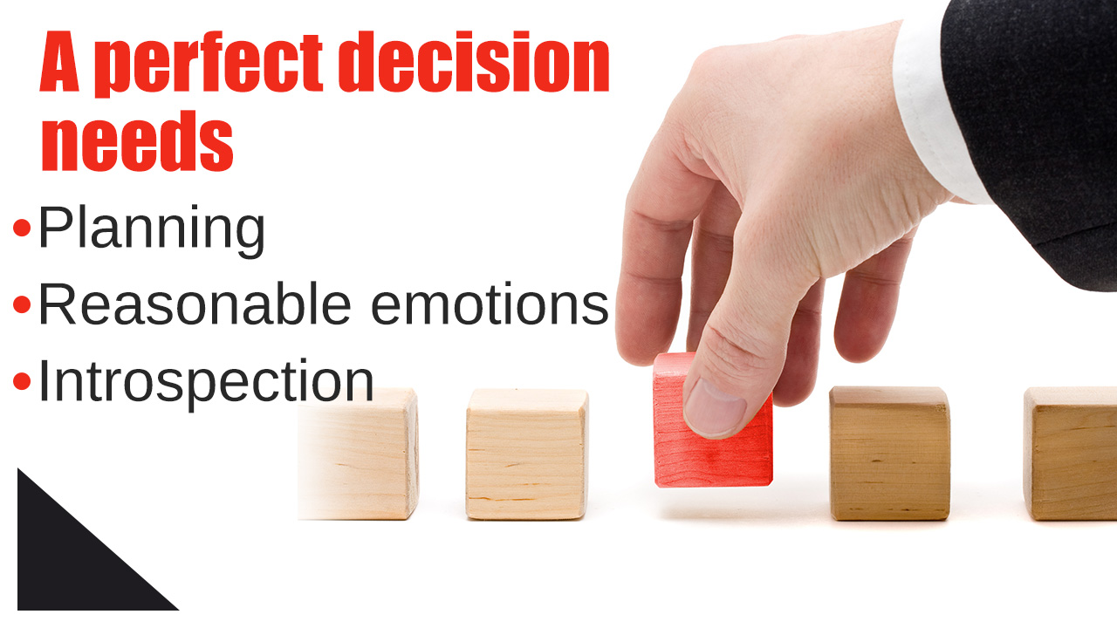
DECISION-MAKING

Slide 45
SYMPTOMS & TREATMENTS OF CHILDHOOD AND DEVELOPMENTAL DISORDERS
Autism Spectrum Disorder (Formerly Asperger’s, Autistic Disorder, & Rett’s)
Attachment Disorder
Attention Deficit/Hyperactivity Disorder (ADHD/ADD)
Autism
Conduct Disorder
Disorder of Written Expression
Disruptive Mood Dysregulation Disorder
Encopresis
Enuresis
Expressive Language Disorder
Mathematics Disorder
Mental Retardation, see Intellectual Disability
Oppositional Defiant Disorder
Reading Disorder
Rumination Disorder
Selective Mutism
Separation Anxiety Disorder
Social (Pragmatic) Communication Disorder
Stereotypic Movement Disorder
Stuttering
Tourette’s Disorder
Transient Tic Disorder

Slide 46
What is a Mental Disorder
“A mental disorder is a syndrome characterized by clinically significant disturbance in an individual’s cognition, emotion regulation, or behavior that reflects a dysfunction in the psychological, biological, or developmental processes underlying mental functioning.”
Reference: http://dsm.psychiatryonline.org/content.aspx?bookid=556&sectionid=41101753

Slide 47

Significant Distress
“Mental disorders are usually associated with significant distress or disability in social, occupational, or other important activities. An expectable or culturally approved response to a common stressor or loss, such as the death of a loved one, is not a mental disorder.”
Reference: http://dsm.psychiatryonline.org/content.aspx?bookid=556&sectionid=41101753

Slide 48
Socially Deviant Behavior
Socially deviant behavior (e.g., political, religious, or sexual) and conflicts that are primarily between the individual and society are not mental disorders unless the deviance or conflict results from a dysfunction in the individual, as described above.
Reference: http://dsm.psychiatryonline.org/content.aspx?bookid=556&sectionid=41101753

Slide 49
CLINICAL UTILITY
The diagnosis of a mental disorder should have clinical utility:
The diagnosis should help clinicians to determine prognosis, treatment plans, and potential treatment outcomes for their patients.
The diagnosis of a mental disorder is not equivalent to a need for treatment.
Reference: DSM V, American Psychiatric Association, 2013.

Slide 50
CLINICAL UTILITY - CONTINUED
Need for treatment is a complex clinical decision that takes into consideration symptom severity, symptom salience (e.g., the presence of suicidal ideation), the patient’s distress (mental pain) associated with the symptom(s), disability related to the patient’s symptoms, risks and benefits of available treatments, and other factors (e.g., psychiatric symptoms complicating other illness).
Clinicians may thus encounter individuals whose symptoms do not meet full criteria for a mental disorder but who demonstrate a clear need for treatment or care.
The fact that some individuals do not show all symptoms indicative of a diagnosis should not be used to justify limiting their access to appropriate care.”

Slide 51
Validation of Diagnostic Criteria
“Approaches to validating diagnostic criteria for discrete categorical mental disorders have included the following types of evidence: antecedent validators (similar genetic markers, family traits, temperament, and environmental exposure), concurrent validators (similar neural substrates, biomarkers, emotional and cognitive processing, and symptom similarity), and predictive validators (similar clinical course and treatment response).”
Reference: DSM V

Slide 52
Online Assessment Measures
http://www.psychiatry.org/practice/dsm/dsm5/online-assessment-measures#Level1
http://www.psychiatry.org/practice/dsm/dsm5

Slide 53
A Stepwise Approach to Differential Diagnosis
Although diagnoses are the stated product of a diag­nostic interview, a good diagnostic interviewer should gener­ate more hypotheses than diagnoses, because an interviewer is investigating the nature of a person's distress (Feinstein 1967).
Reference: Nussbaum, A. (2013). The Pocket Guide to the DSM 5 Diagnostic Exam, Published by: American Psychiatric Association.

Slide 54
6 Steps
Step 1: Consider to What Extent the Signs and Symptoms Are Intentionally Produced
Step 2: Consider to What Extent the Signs and Symptoms Are Related to Substances
Step 3: Consider to What Extent the Signs and Symptoms Are Related to Another Medical Condition
Step 4: Consider to What Extent the Signs and Symptoms Are Related to a Developmental Conflict or Stage
Reference: Nussbaum, A. (2013). The Pocket Guide to the DSM 5 Diagnostic Exam, Published by: American Psychiatric Association.

Slide 55
Continued…
Step 5: Consider to What Extent the Signs and Symptoms Are Related to a Mental Disorder
Step 6: Consider Whether No Mental Disorder Is Present

Slide 56
NURSING CONSIDERATIONS FOR THE CHILD IN THE COMMUNITY
Identifying children in need of urgent care or isolation
Performing nursing assessments, including the health history, vital signs, growth and development, nutritional status, immunization status, family strengths and challenges
Conducting physical examinations
Performing age-appropriate screening tests to detect health problems such as vision or hearing loss, anemia, and lead poisoning to ensure that the child has access to all needed health services
Assisting with health examinations, diagnostic tests, and procedures
Developing nursing diagnoses and implementing a plan of care
Providing immunizations
Providing information about procedures and offering reassurance
Providing patient education for health promotion or management of the health condition
Linking families with community resources
Ensuring a safe healthcare setting and adherence to infection control guidelines (See the Clinical Skills Manual SKILLS for infection control methods.)
Participating in the health center’s performance improvement program to identify ways to enhance services provided to children and their families

Slide 57
CONCLUDING REMARKS

